Slide 1
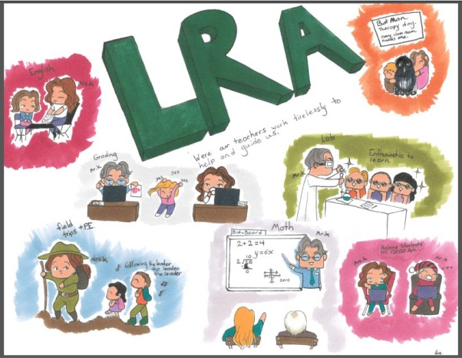
Lewis River Academy
Multi-District Provider Status
2013-2016

Slide 2
The Requirements
RCW 28A.250 Requires online academies with more than 10% its enrollment on boundary exception seek multi-district provider approval.
The definition of online provider applies to LRA not Team High as our program is defined as “mostly taught by a teacher from a remote location” while at Team students attend campus regularly.

Slide 3
A snapshot of the criteria
The application criteria categories:
A. Course content and Instruction Design
Student Assessment
Classroom Management
Course Evaluation and Management
Student Support
School-Based Support
Technology
Staff Development and Support
Program Management
Total of 211 pieces of evidence were submitted to complete the application

Slide 4
Status of our application…
Approved!

Slide 5
What does this mean?
We are now one of 5 programs in the state that can serve students outside our boundary in grades K-12.
We are the only one in Southwest WA
We can begin working on inter-district agreements

Slide 6
Next Steps
Seeking Full Accreditation status
We will be reviewed by local administrators and Northwest Accreditation April 18th
Meet with local Superintendents to describe the program and the possible benefits to their community.
Spread the word
www.lewisriveracademy.org

